Slide 1

Waikato Institute of Technology
The inter-connections of our tools, practices and security management.

Slide 2

About Wintec
Wintec offers services to
20,000 students from 52 countries
Employs around 840 staff members.
currently provides courses with
10 degrees
35 diplomas
12 postgraduate qualifications.
We have three main campuses here in Hamilton
the main city site
Rotorkauri in north Hamilton
Hamilton gardens horticultural campus.
Wintec ITS support these staff and students with IT services such as
Moodle
Wintec website
SharePoint
PC and network access on campus
a host of other important applications and support.

Slide 3

Content
ITSM Tool Zendesk
ITIL Practices
Information security management

Slide 4
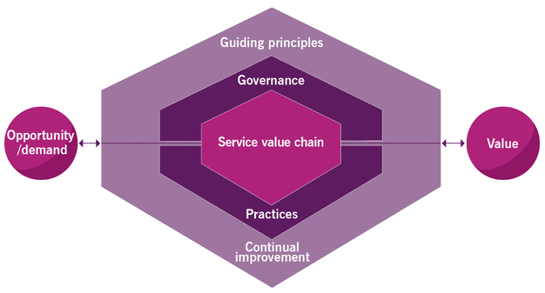
Value
Outline
Is the perceived benefits, usefulness and importance of something.
SVS
Stakeholders
Zendesk’s functions that support value

Slide 5

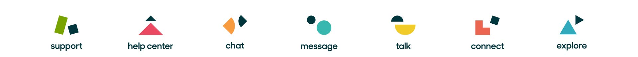
Zendesk
Zendesk is an ITSM tool used to ensure reliable and effective support for the business’s users.
Talking About:
Support
Guide
Talk
Explore

Slide 6
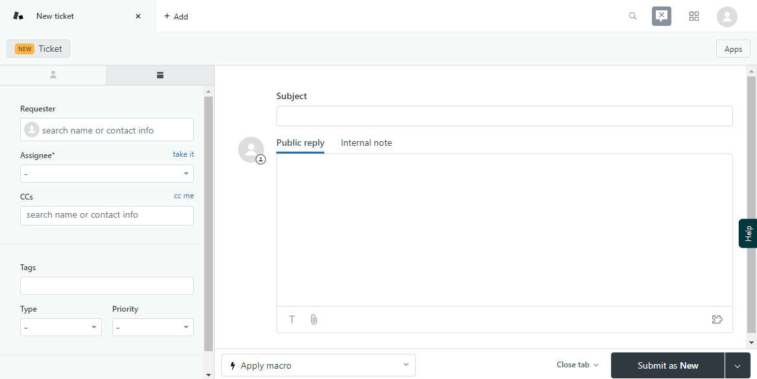
Support
Ticketing Page:
the gathering of incidents and support requests from multiple platforms.
Request for support and identification of common problems

Slide 7
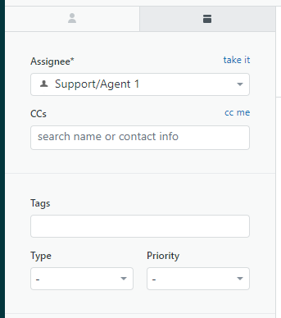
Support
Priority:
Order of possible completion
High priority users (E.G. Teachers)
Prioritise security threats

Slide 8
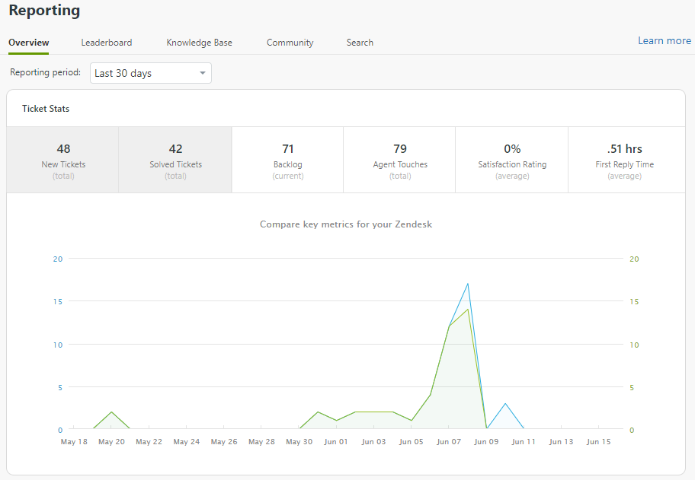
Support
Graphing Page:
View and mange completed or unsolved tickets
Identify possible problems through frequent incidents
Supports continual improvement by identifying needs

Slide 9
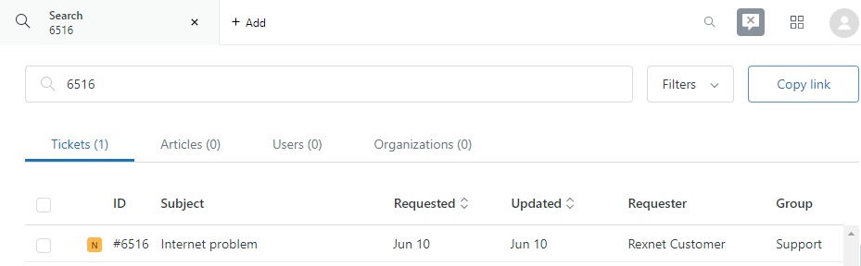
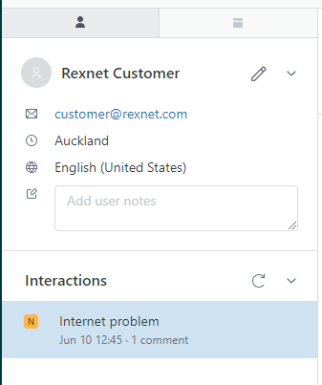

Ticket Navigation
Tickets can be
Searched
Filtered
Prioritized
Referenced to a previous end-user

Slide 10
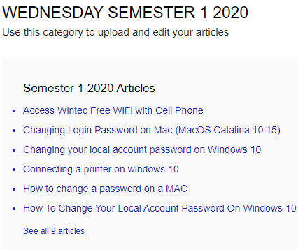
Guide
Guide Features:
Distribution of knowledge
Reduces quantity of basic repetitive tickets
Allows users to research a solution
Includes an answer bot to recommend related articles.

Slide 11
Talk
Perks of talk:
Quickly resolve issues
Call recording
Allows audio conformation of identification

Slide 12
Explore
Allows you to:
Collect and act on trends
Personalize graphs for specific use cases
Put in place access restrictions for groups or people

Slide 13
Example Outline
A user has been locked out of their account and is requesting a password reset.

Slide 14
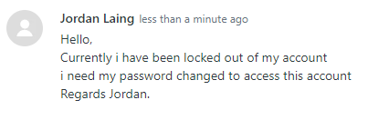
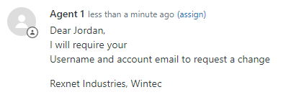
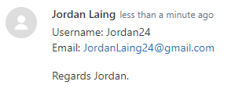
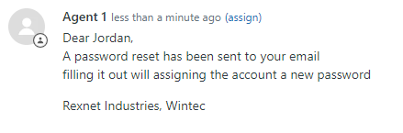
Example
Support App:
A ticket is posted and received by the support staff.
A response is written and sent back requesting valid authentication for access.
Valid authentication is received, and the password is changed.

Slide 15
Example
Guide App:
If this problem is frequent
Post a step by step process for changing the account password without support staff intervention to the guide database

Slide 16
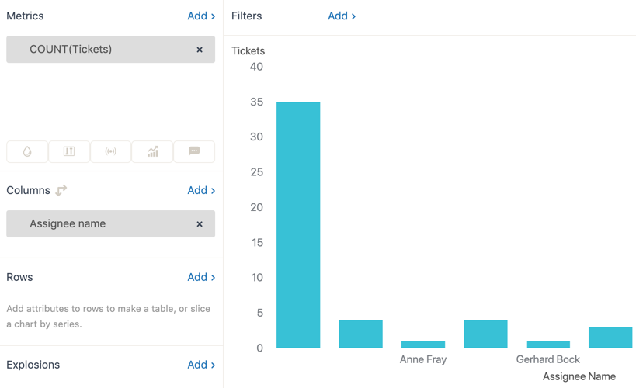
Example
Explore App:
Can be used to verify the frequency of these requests.
To ensure that producing a guide benefits for the time spent

Slide 17
Information Security Management
Outline:
Information security management is the process to protect information needed or used by the organisation to conduct business with users.
Techniques: prevent, detect and correct
Through mitigation techniques and policies

Slide 18
Information Security Management
Common Threats:
Phishing
Social Engineering
Malware
When Creating Security:
Not all account require the best
What information does the account access
What would happen in the event of a breach

Slide 19
Information Security Management Detect
Common Detection
IDSoftware
Traffic monitoring
Malicious behavior monitoring

Slide 20
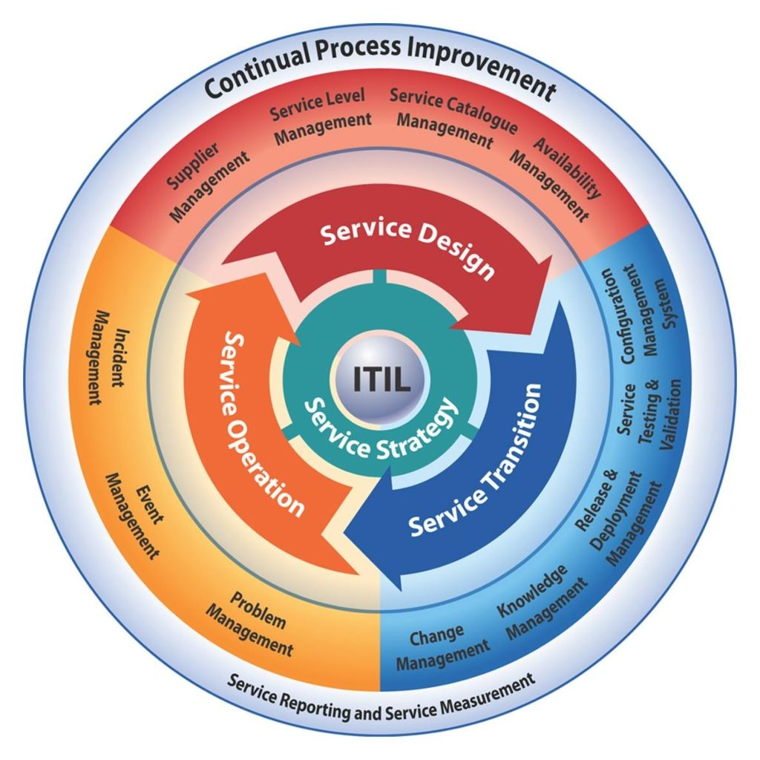
ITIL Practices
ITIL Practices are used to create value for the company. Providing services at adequate levels and supporting the stakeholders and user needs.

Slide 21
Continual Improvement
Continual improvement is a practice to ensure the companies practice's meet stakeholder expectations.
Zendesk’s Support:
Analyzing and representations of data
Graph statistics

Slide 22
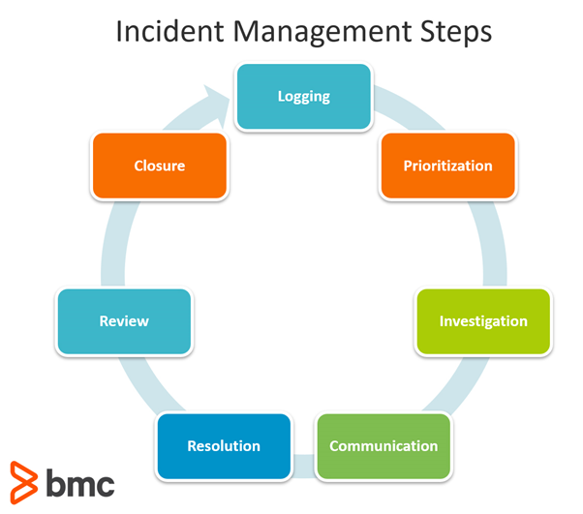
Incident Management
Is the correction of unplanned interruptions to a service

Slide 23
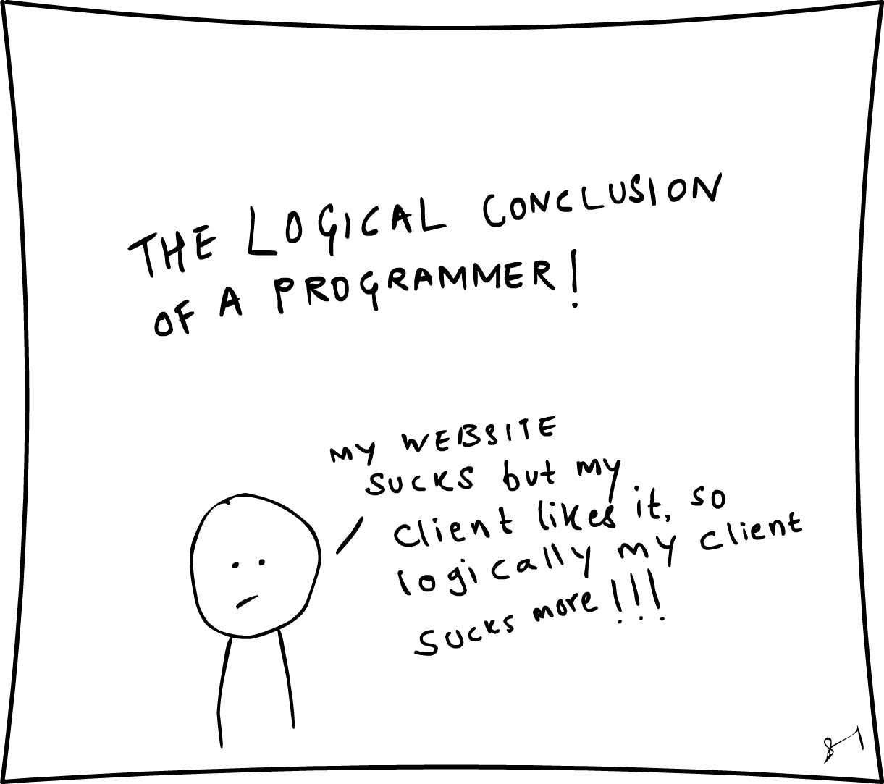
Conclusion
ITIL Practices interconnected with ITSM tool
ITSM tool Zendesk is a strong capable system
Value commonly associated with ITIL

